Slide 1

Project 12 Mathematical Reconstruction of Patient-Specific Vascular Network Based on Clinical Images and Global Optimization
Students: Yifan Jiang¹, Abdul Hannan Faruqi², Junhong Shen³
Supervisor: Dr. Nima Maftoon (University of Waterloo)
^{1 University of Toronto}
^{2 Aligarh Muslim University}
3 University of California, Los Angeles

Slide 2
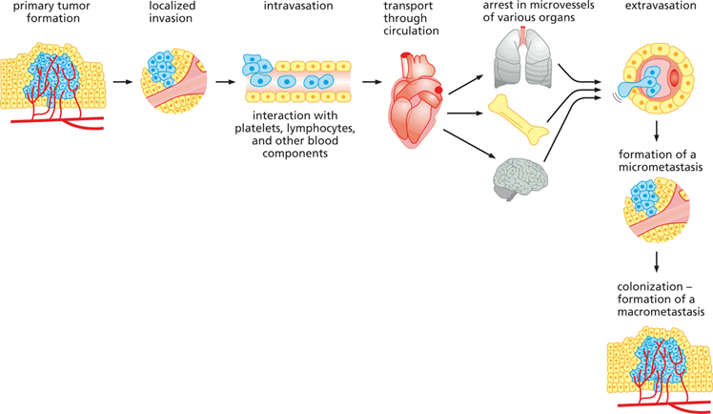
Motivation
Metastasis
Modelling tumor growth and its vascularization
Blood flow plays a vital role in metastasis.
To study circulating tumor cells in metastasis and the location of secondary tumor sites detailed geometry of vascular network is needed.
Our computational framework is aimed at providing this detailed network structure which could aid in predicting metastasis sites.

Slide 3
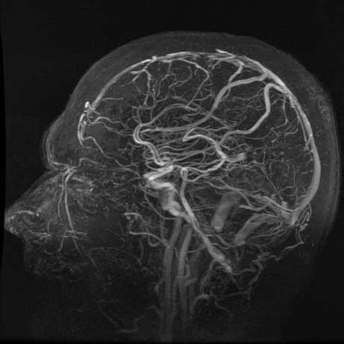
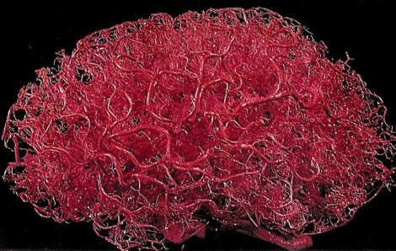
Patient-specific Vascular Network
Brain Angiography
Idealized Brain Vascular Network

Slide 4
Our Framework
Image-based 3D Vessel Reconstruction with Structure Approximation
Medical Image Preprocessing
Large Vessel Extraction
Optimization-based Structure Refinement (Global Constructive Optimization)
Volume Generation
Postprocessing
Global optimization solved by GCO: merge / split / prune
Local optimization solved by relaxation

Slide 5
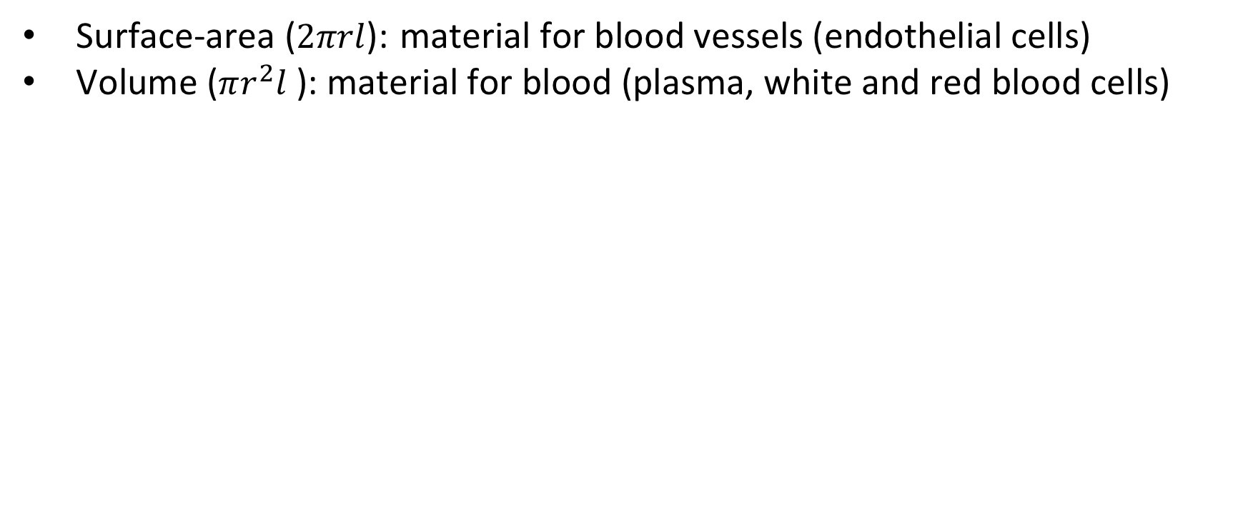
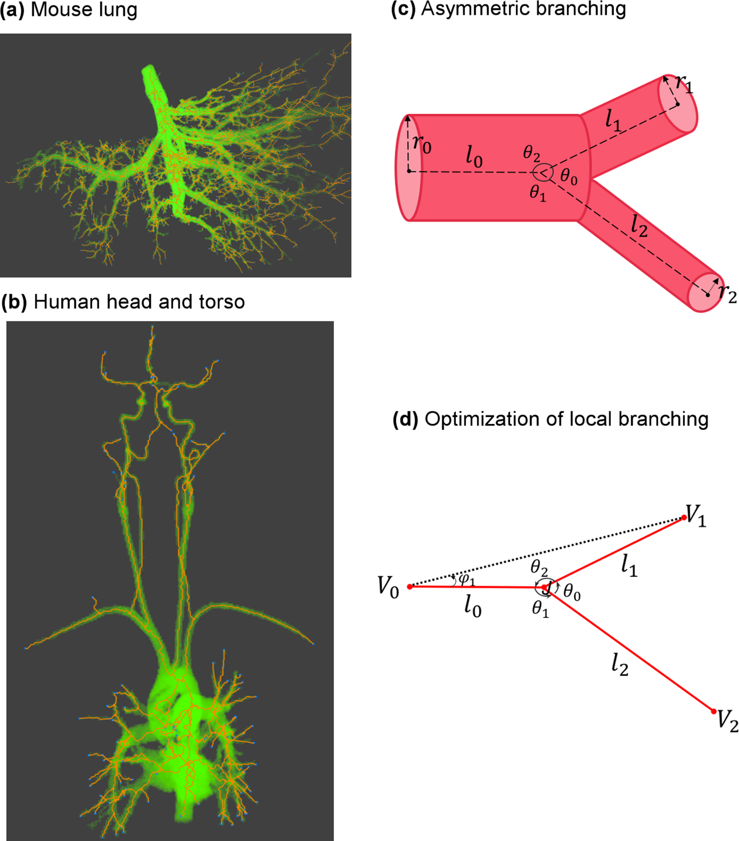
Cost Function: Material Cost
3D Model of Bifurcation

Slide 6
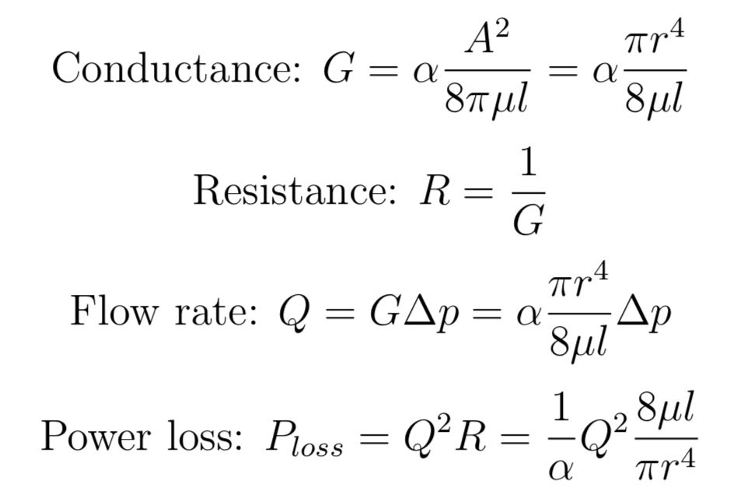
Cost Function: Power Cost
Power loss during blood circulation

Slide 7
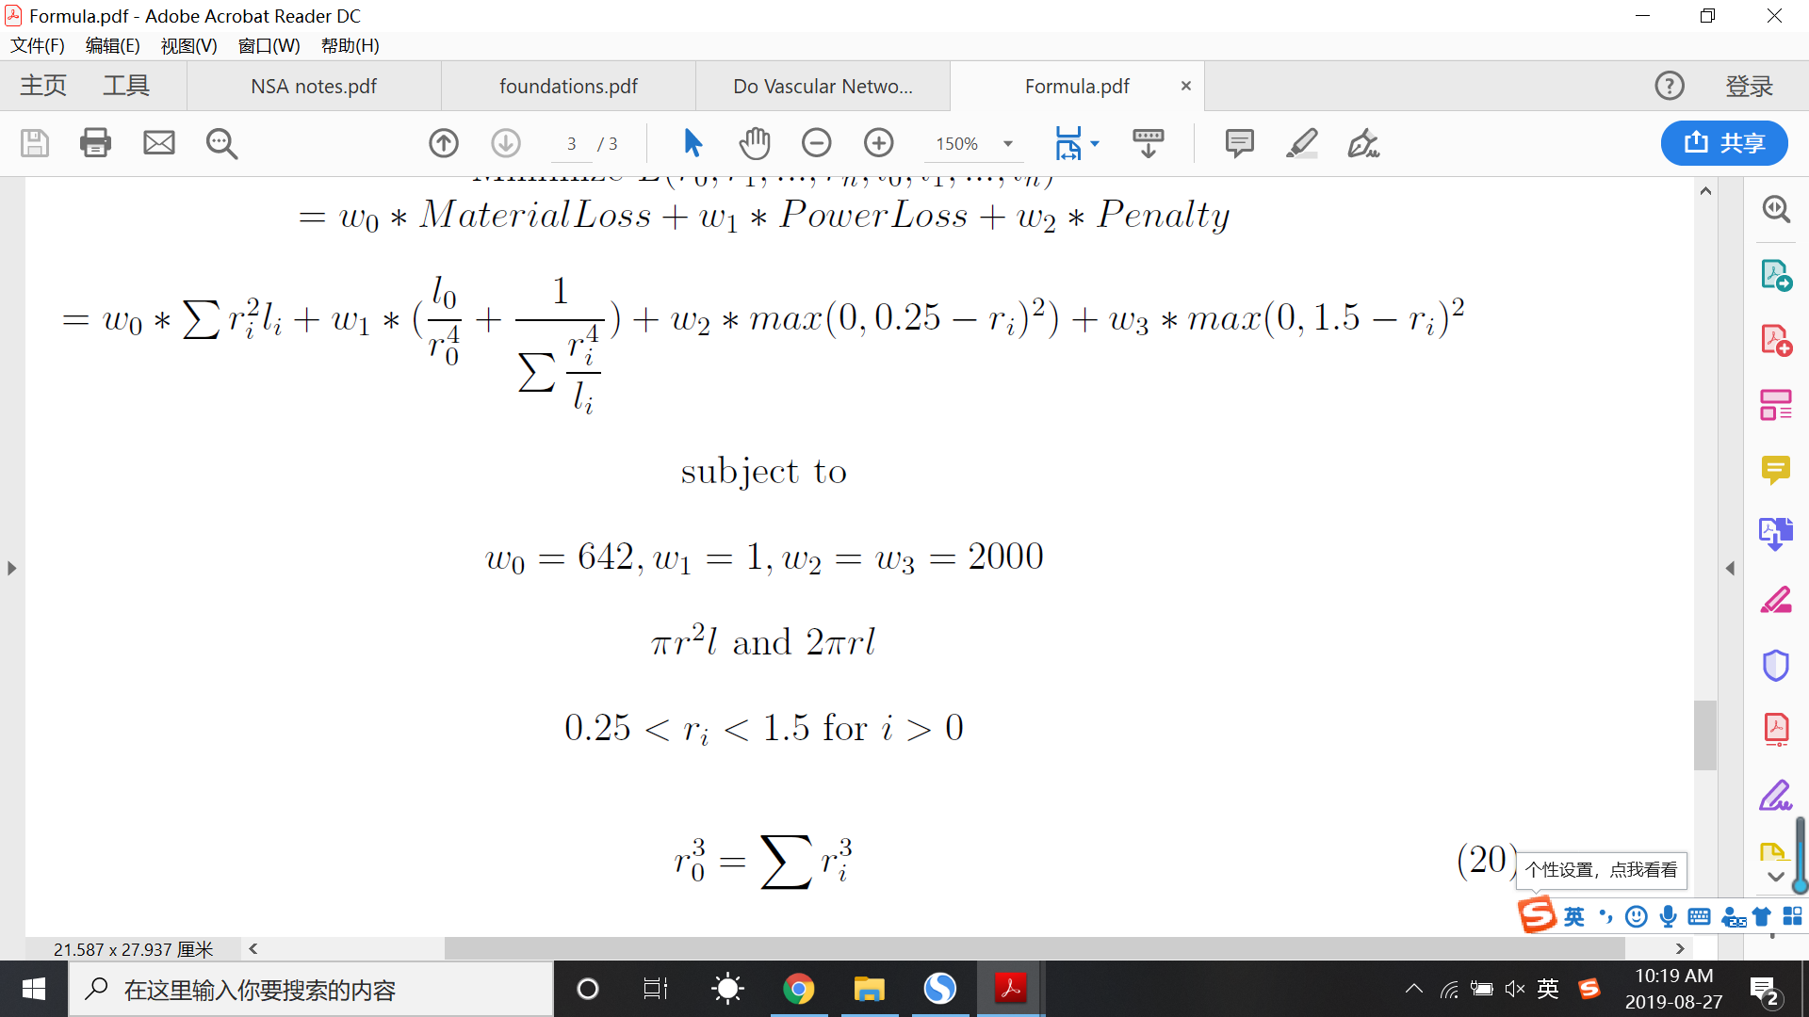
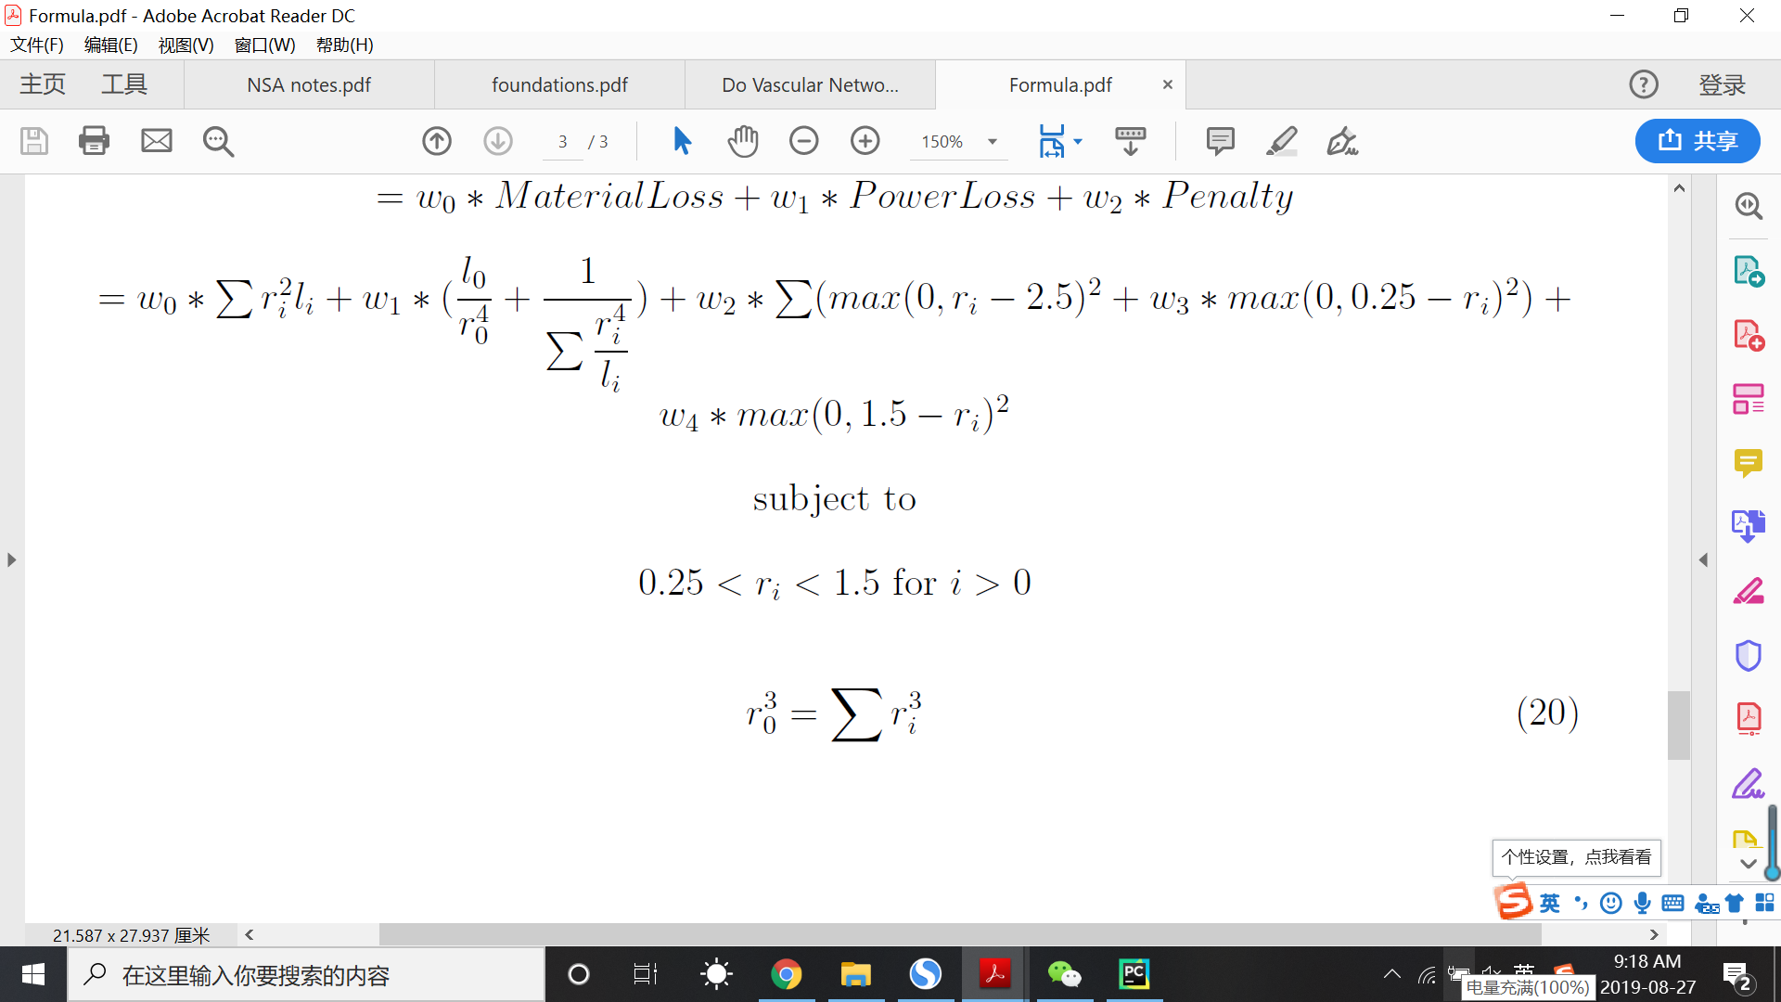
Cost Function for Relaxation
subject to:
Illustration of MC
Illustration of PC

Slide 8
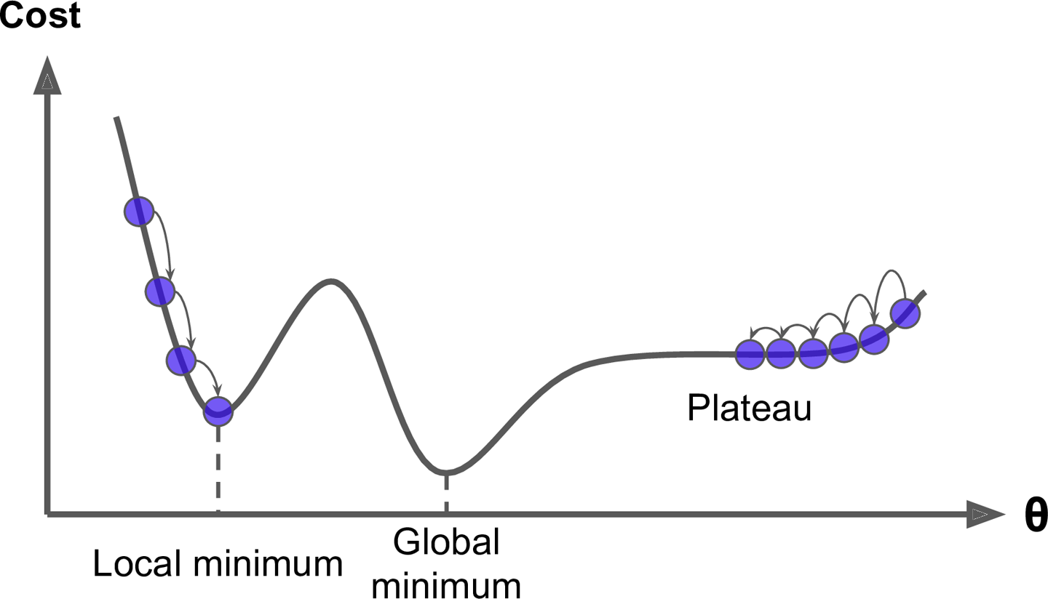
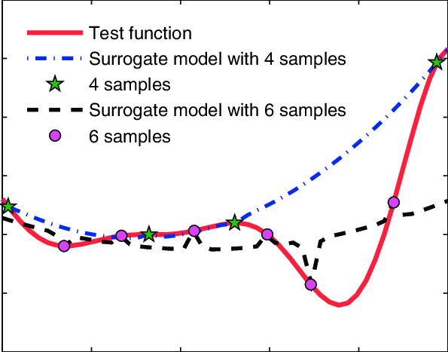

Optimization Algorithm: Selection
Surrogate-based Modelling
Approximates the actual objective function based
on sampled points and then gives the minimum
Gradient-Descent
Follows the gradient to reach the
optimum point
Simulated Annealing
Samples multiple points in the domain
and then narrows down to an optimum
Cost Change for SM
Source: ResearchGate - Erich Wehrle
Cost Change for GD
Source: Hands-on Machine Learning - O’Reilly
Cost Change for SA
Source: Wikipedia

Slide 9
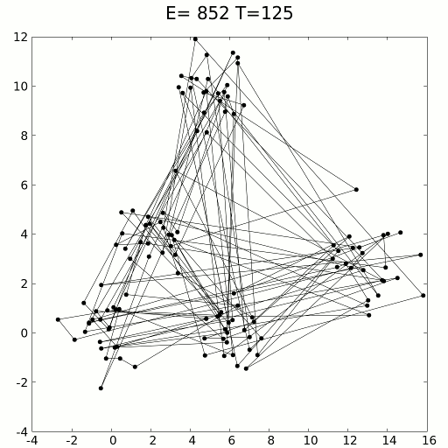
Optimization Algorithm
Simulated Annealing
An optimization method inspired by annealing process in metallurgy.
Has high probability of acceptance in the beginning and it decreases with temperature (iterations).
Finds the global optimum when there are multiple local optima.
Simulated Annealing Example
Source: Wikipedia

Slide 10
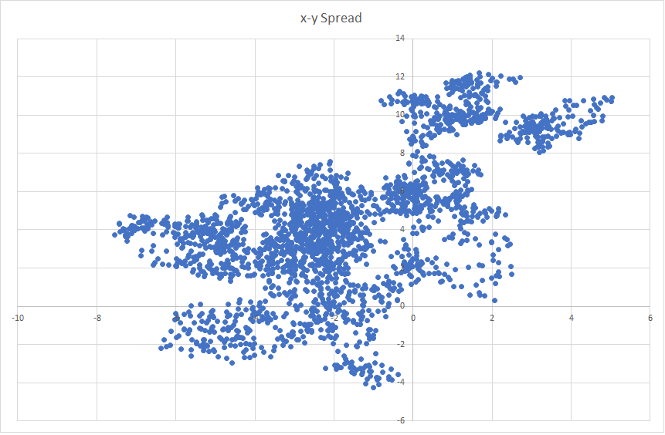
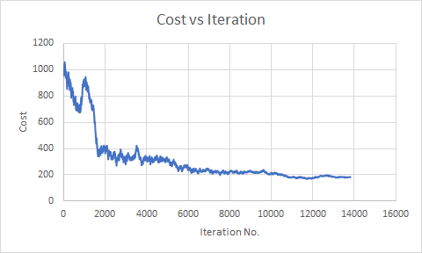
Optimization Algorithm: Results
Finding the global minimum using simulated annealing.
Locations of Points sampled
Change of Cost Function

Slide 11
Optimization Algorithm: Parameters
Important parameters for Simulated Annealing:
Temperature (Chosen value = 1)
It defines the acceptance probability of a bad move. (Good moves are always accepted)
Cooling coefficient (Chosen value = 0.999)
It affects the ability to reach equilibrium
Move Function (Function = [-1, 1] * 0.005 * range)
It defines the ability of exploring the domain

Slide 12
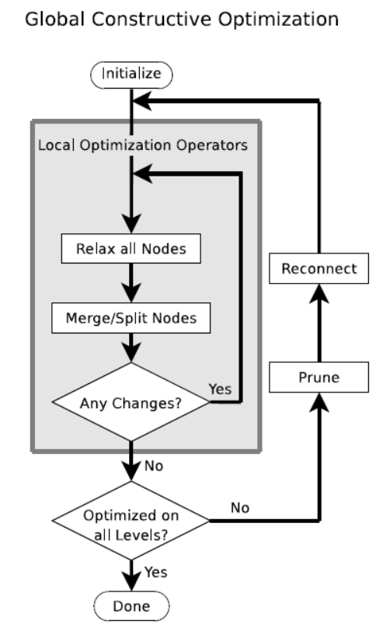
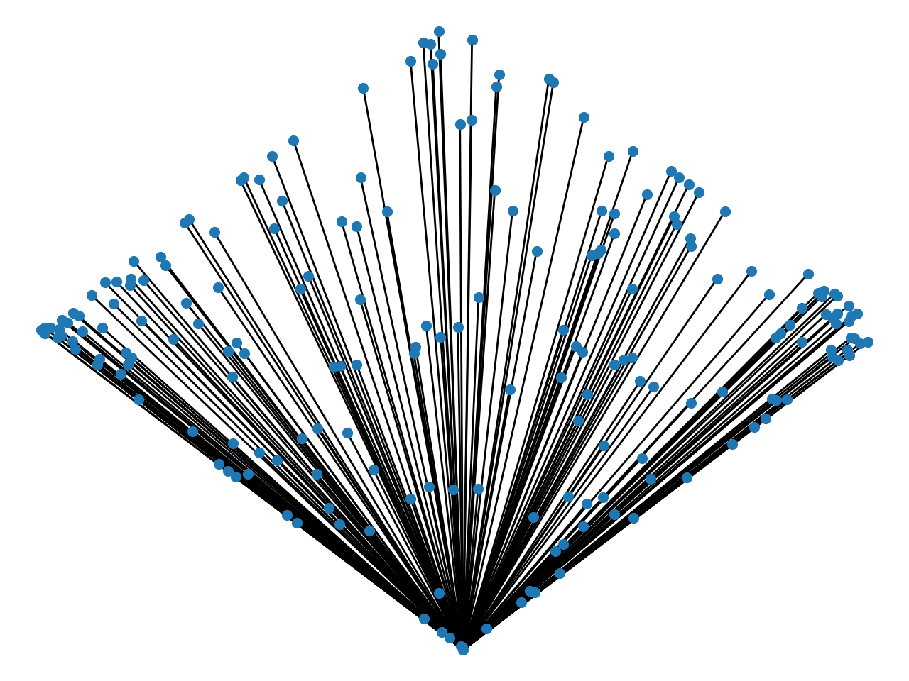
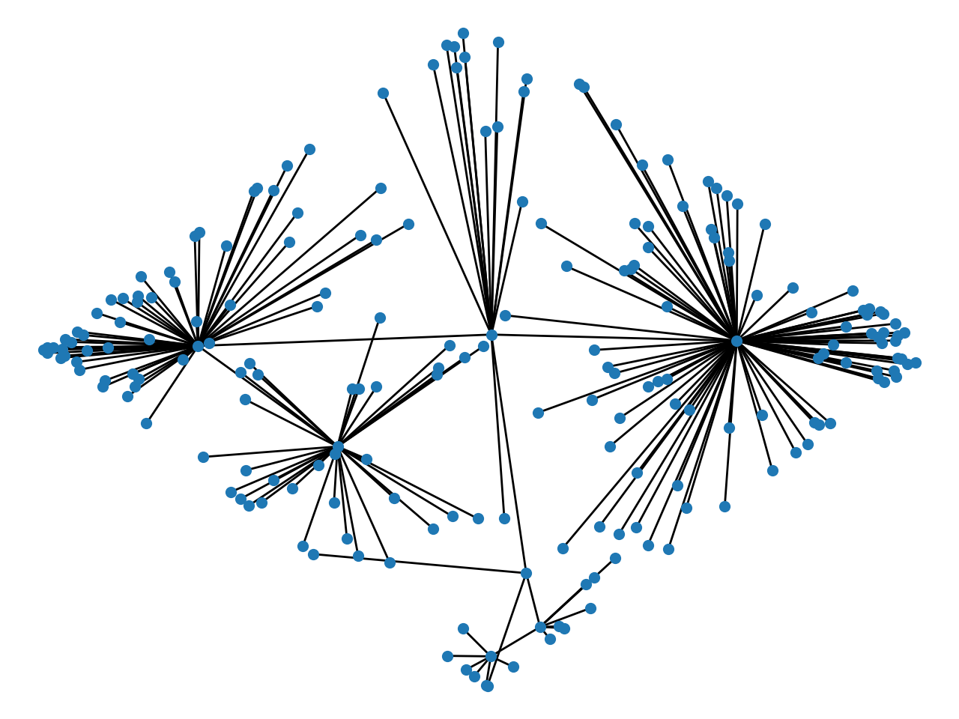
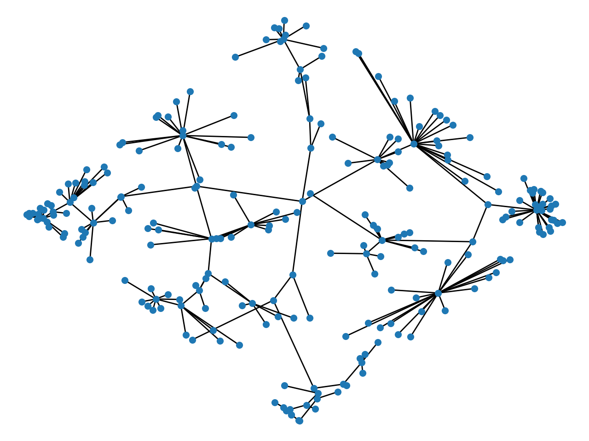
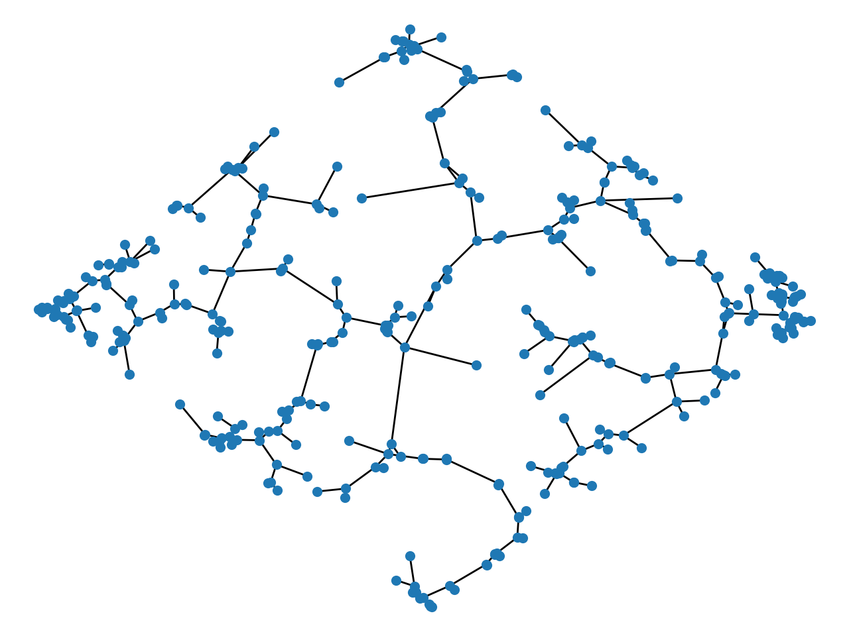
GCO Implementation (2D)
(1) Initialization
(2) Split
(3) Prune and Reconnect
(4) Result
GCO Algorithm

Slide 13
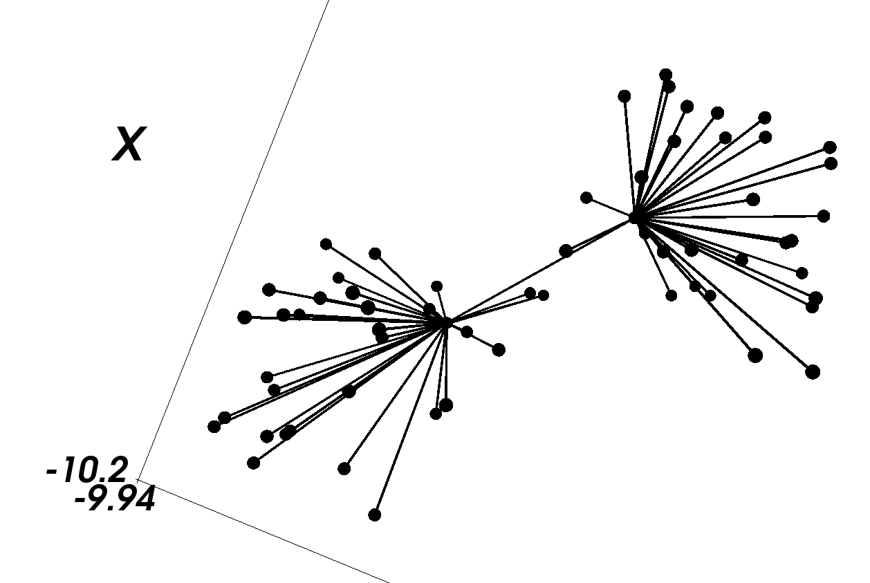
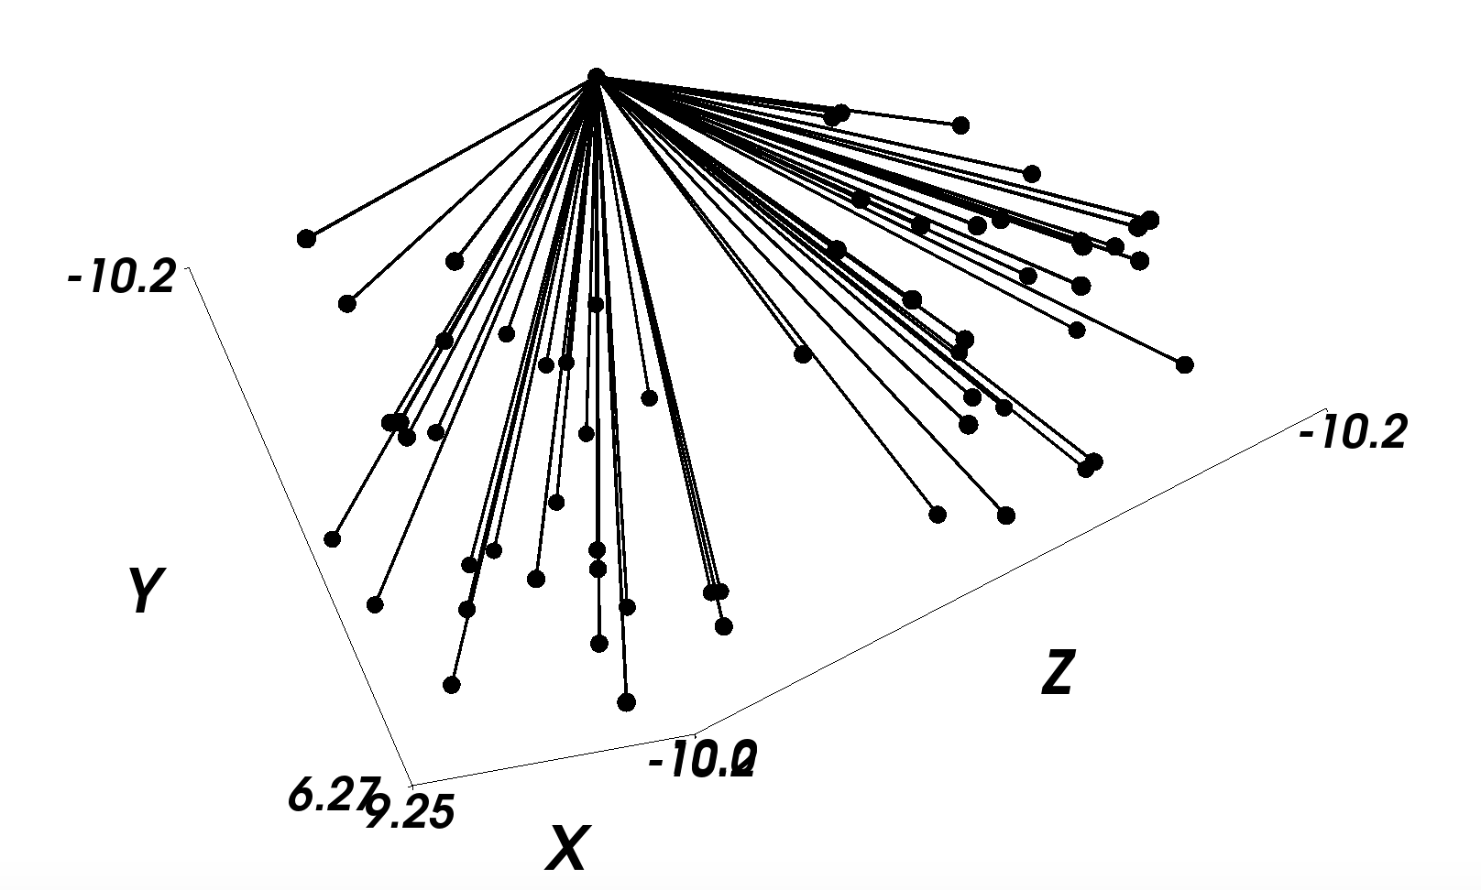
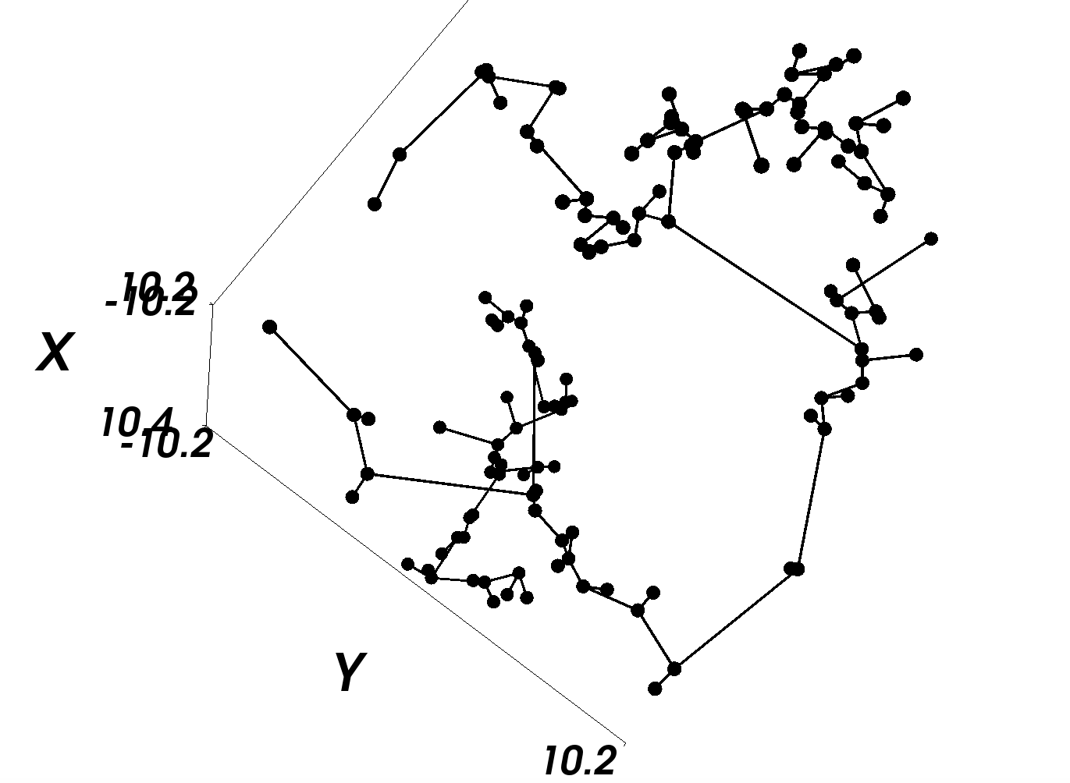
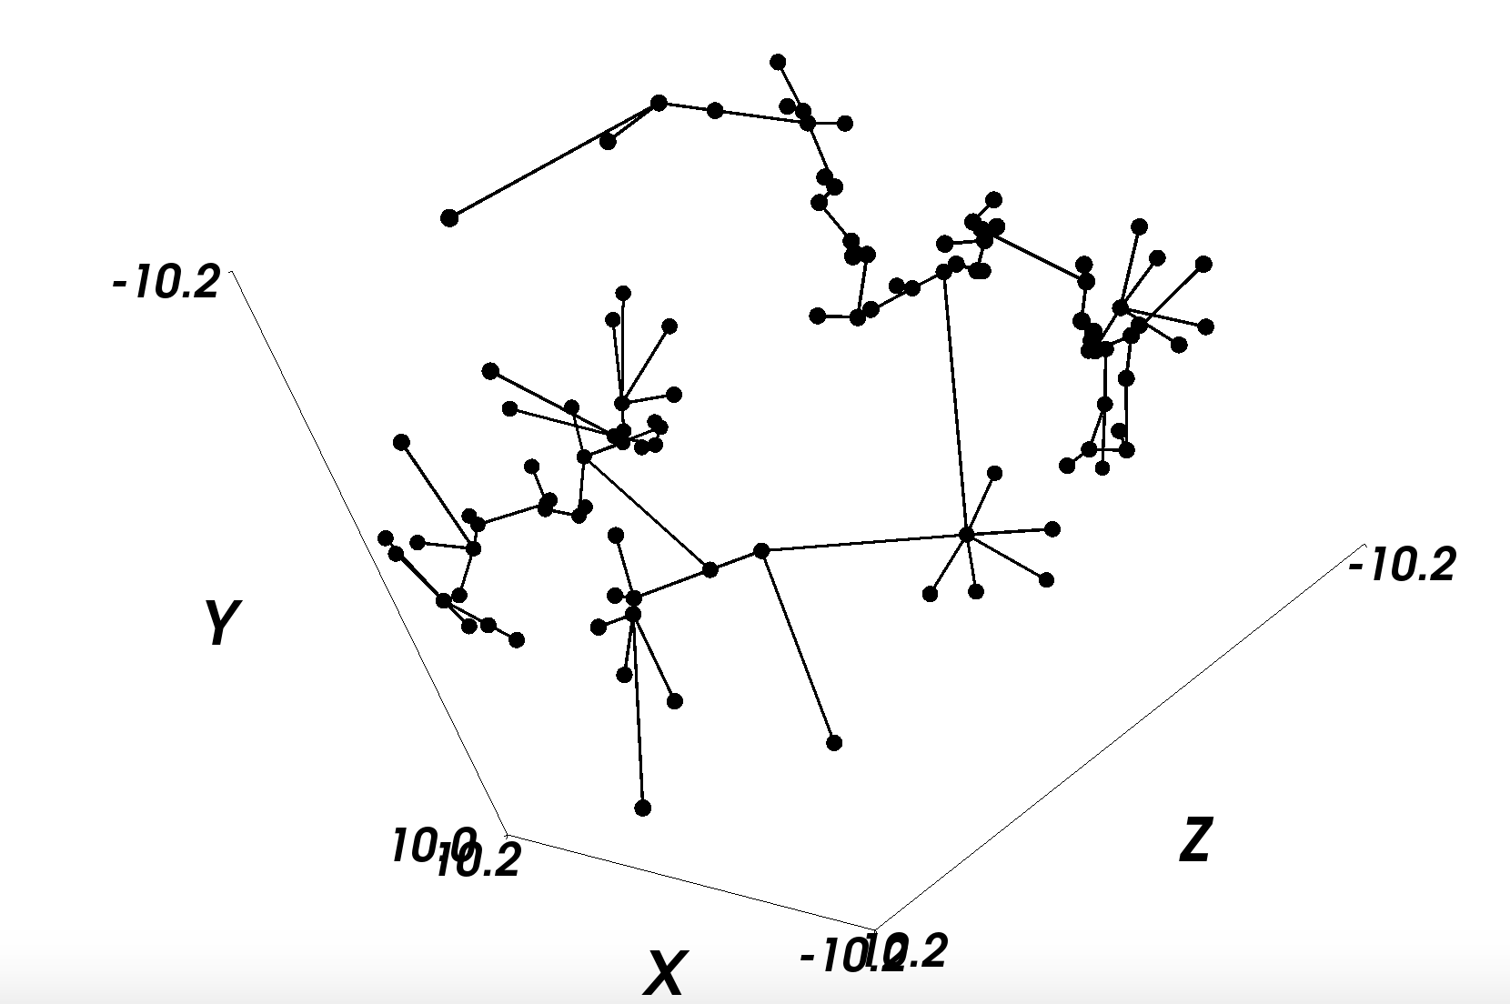
GCO Implementation (3D)
(1) Initialization
(2) Split
(3) Relax
(4) Result
GCO in 3D

Slide 14
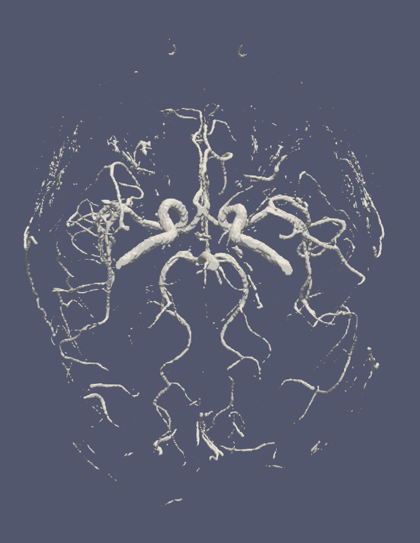
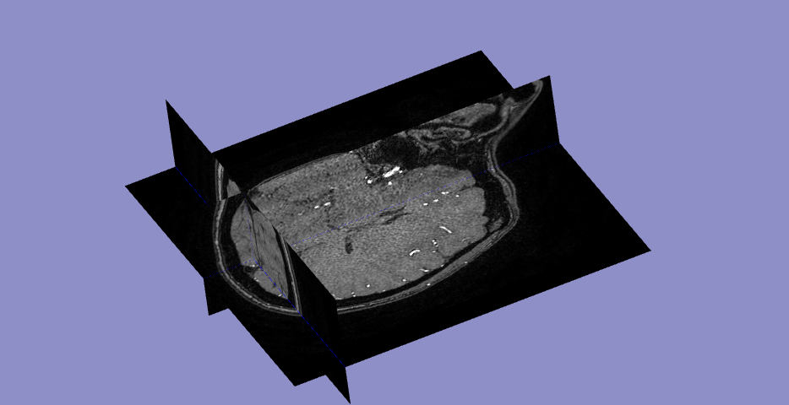
Locate Fixed Nodes: Extract Main Vessels
Brain vessel segmentation from angiography using NiftyNet
3D Brain Angiography
Segmented Vessel Mesh

Slide 15
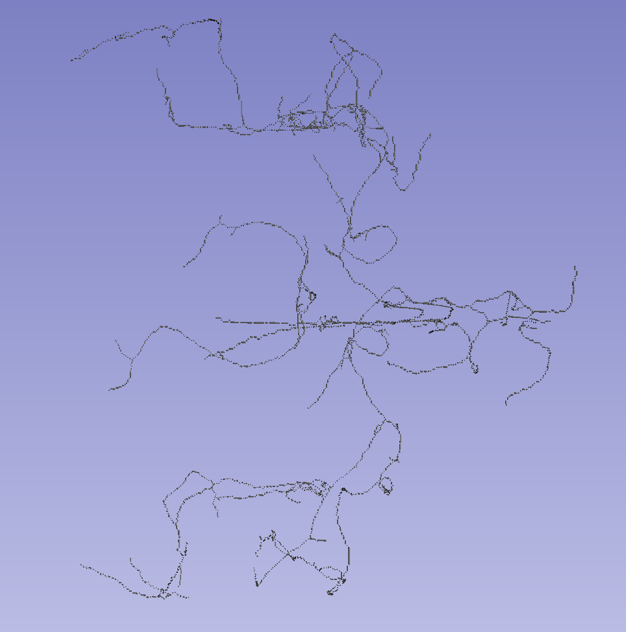
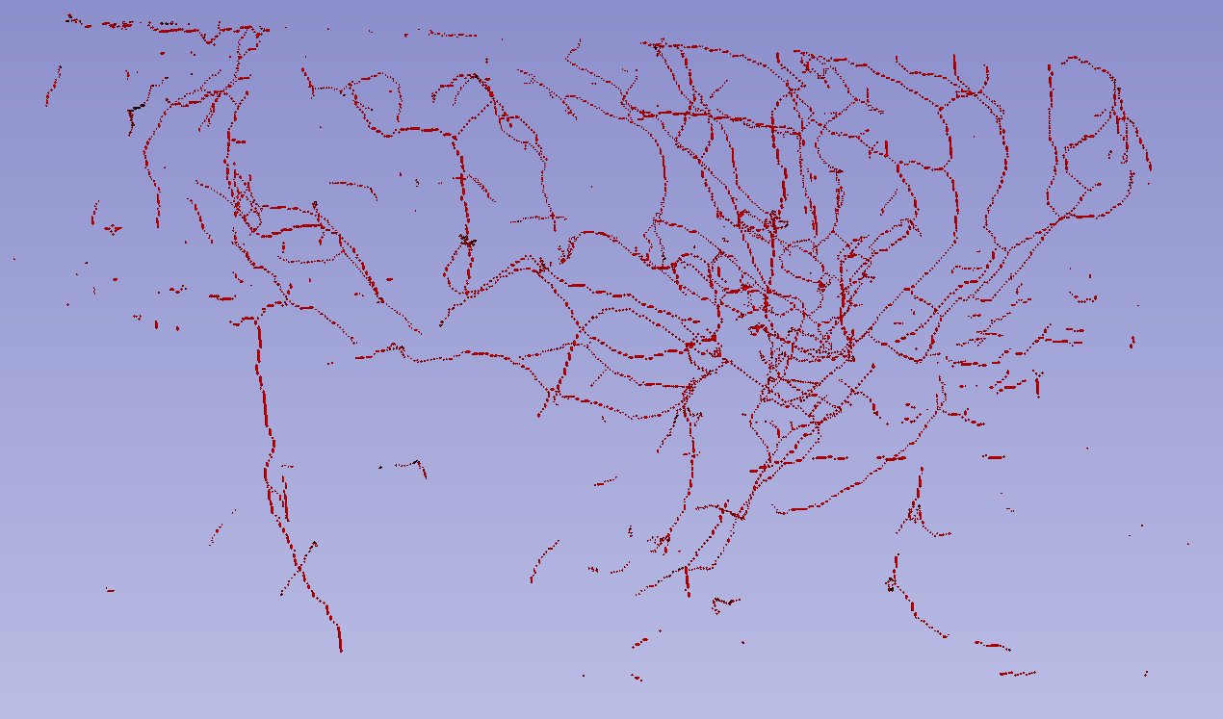
Locate Fixed Nodes: Extract Main Vessels
Voxelize: mesh -> 3D binary array
Connected component analysis: obtain two main vessels
Voxel Representation of Vessels
Voxel Representation of Main Vessel Parts

Slide 16
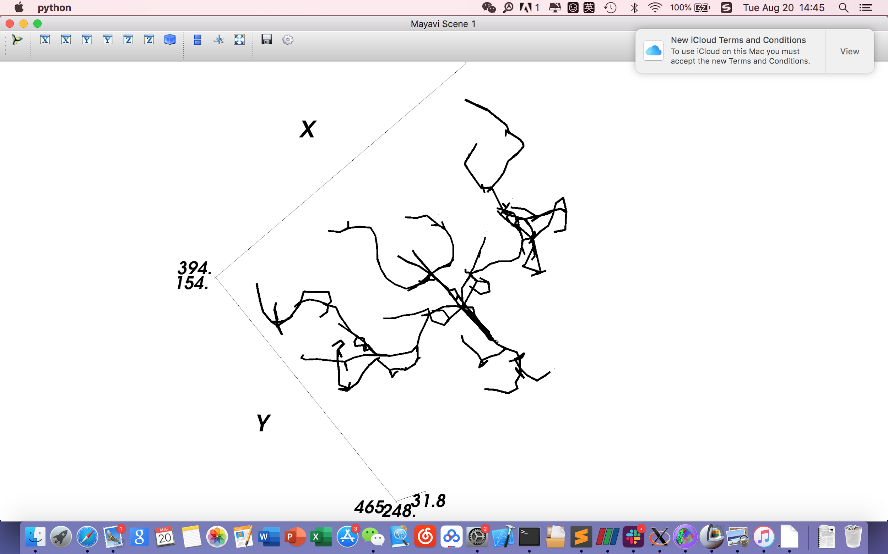
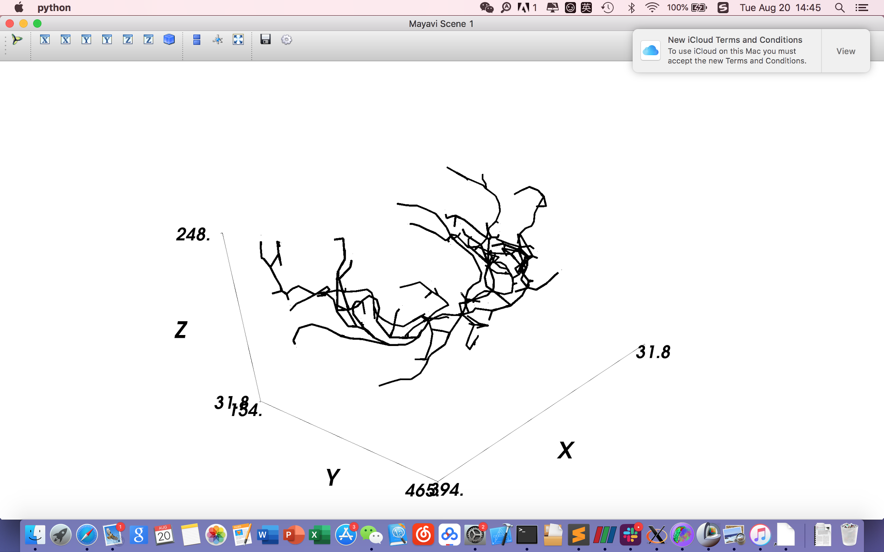
Locate Fixed Nodes: Node and Edge Representation
Sample points (coordinates) from the vessels to retain the main structure of the network
Node and Edge Representation of Main Vessels

Slide 17
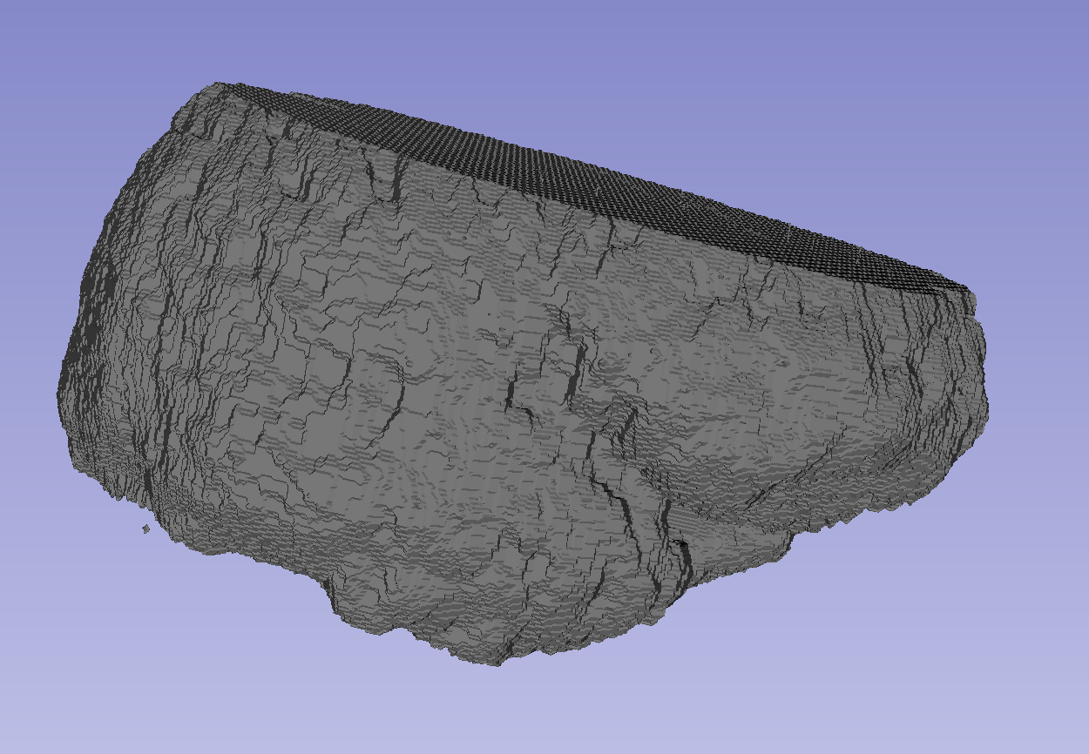
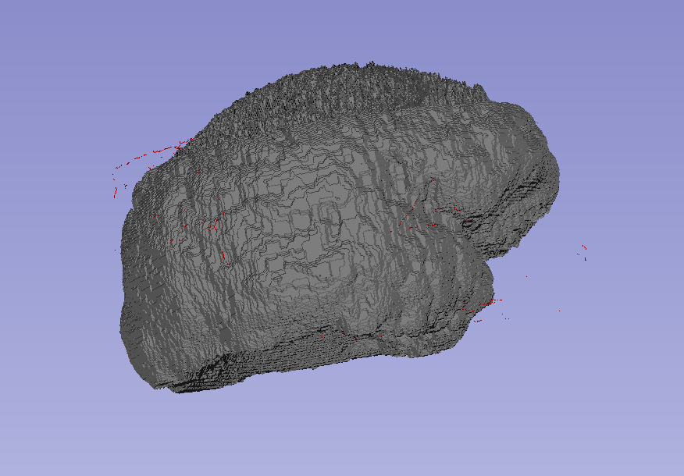
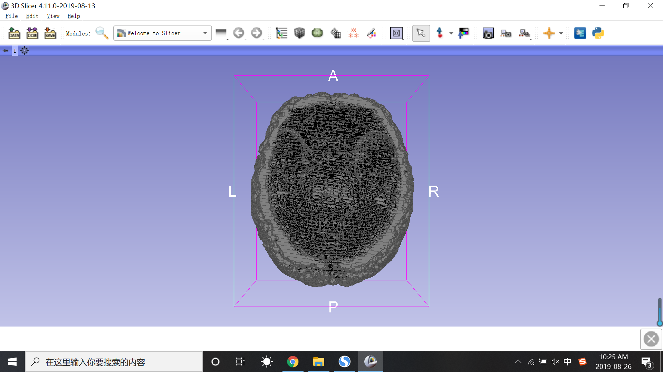
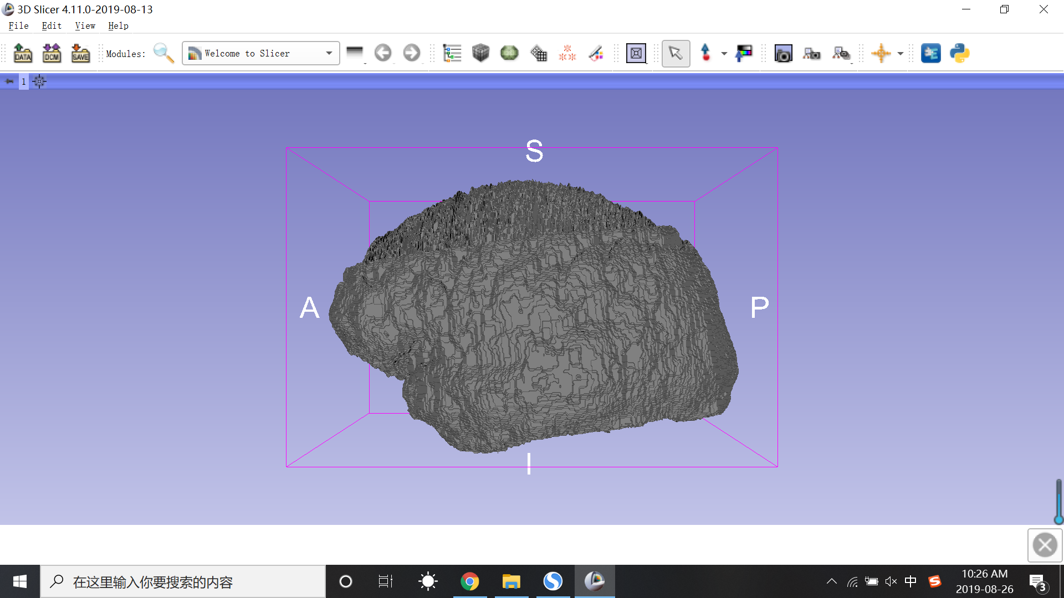
Sample Leaf Nodes: Parametrization
Brain Model Without Parametrization
Brain Model With Parametrization

Slide 18
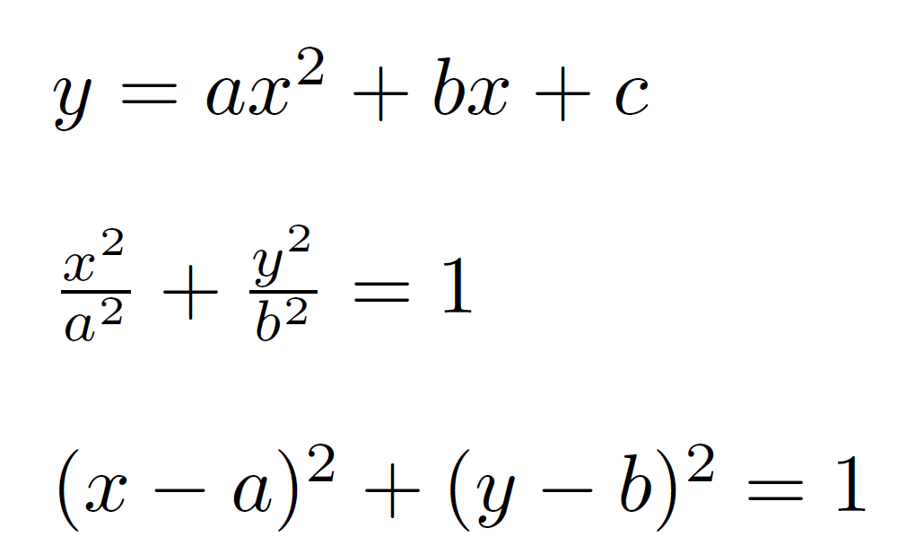
Sample Leaf Nodes: Approach
Take 512 slices and fit the curve with several mathematical expression.
Polynomial fit:
Ellipse fit:
Circle fit:

Slide 19
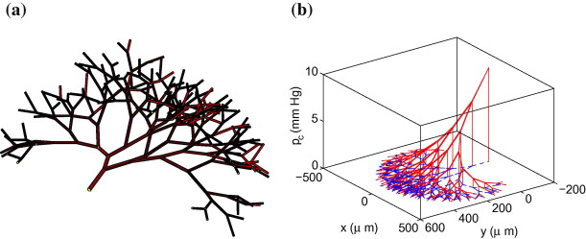
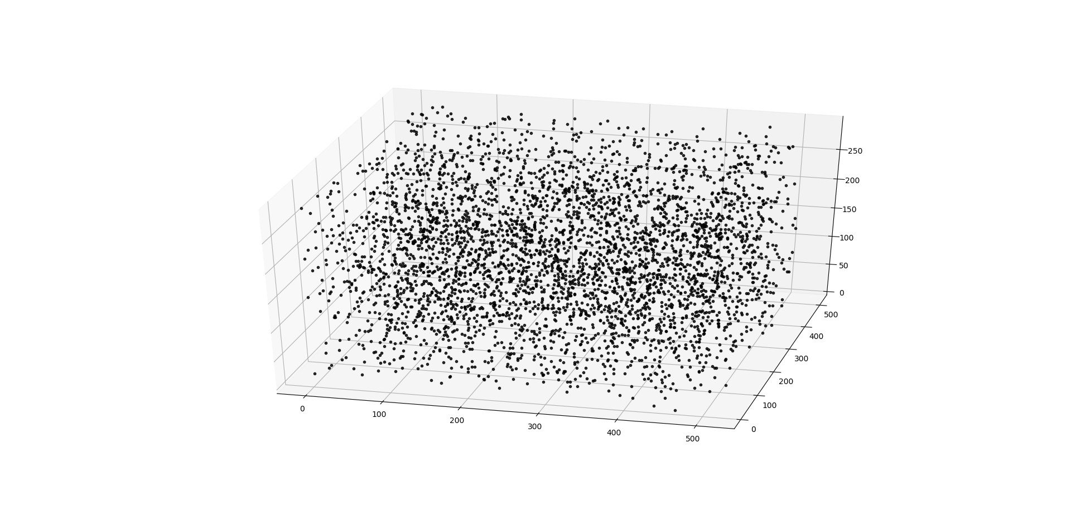
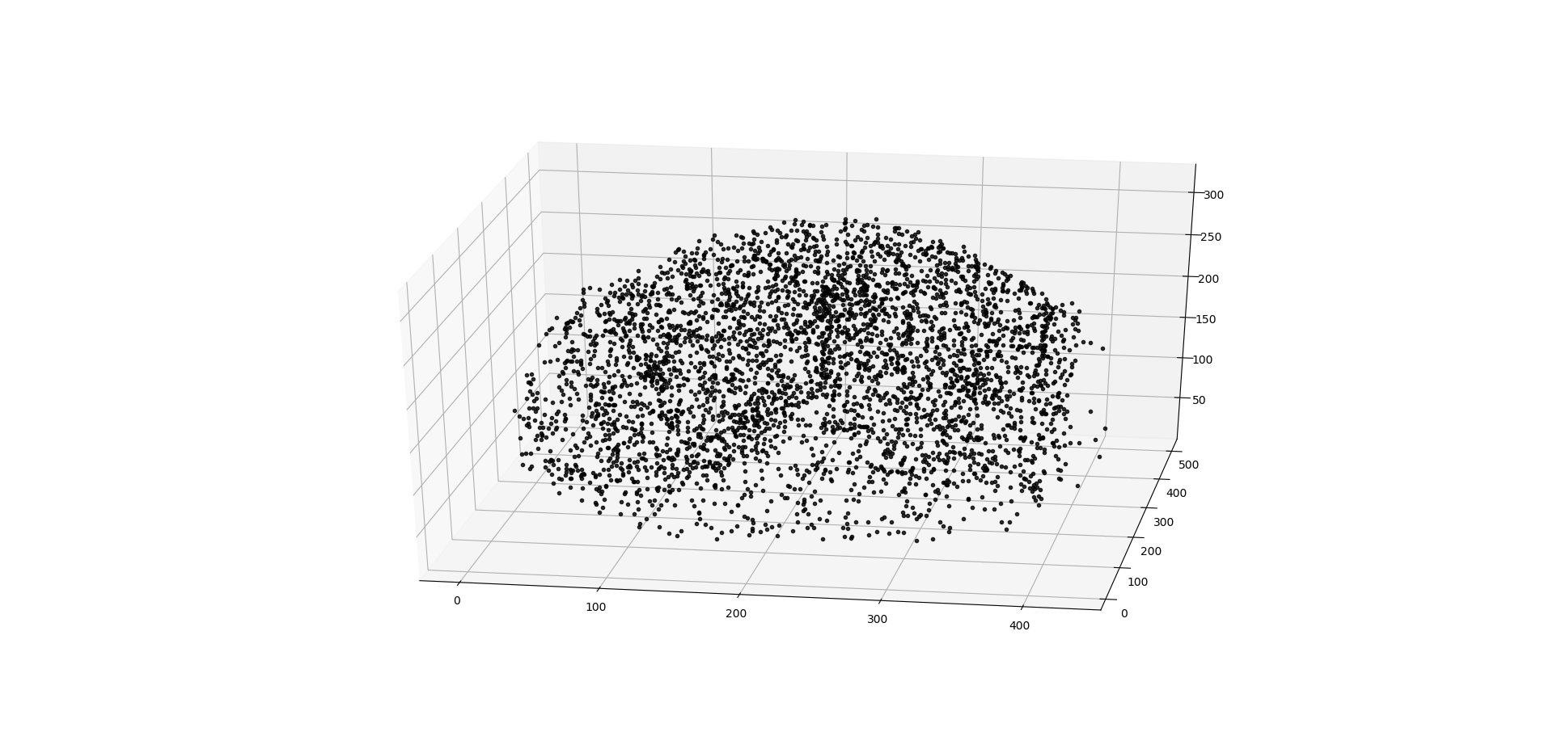
Sampling Algorithm: Region of Influence
Randomly sample some points in the domain and define a region of influence around each point
Rearrange the points to fill unsupplied regions
The Algorithm:
Find misses
Find overlaps + outliers
Move these points to missed regions
Add more points, if needed
Source: ScienceDirect - C.Pozrikidis, J.M.Davis
Region of Influence Example

Slide 20
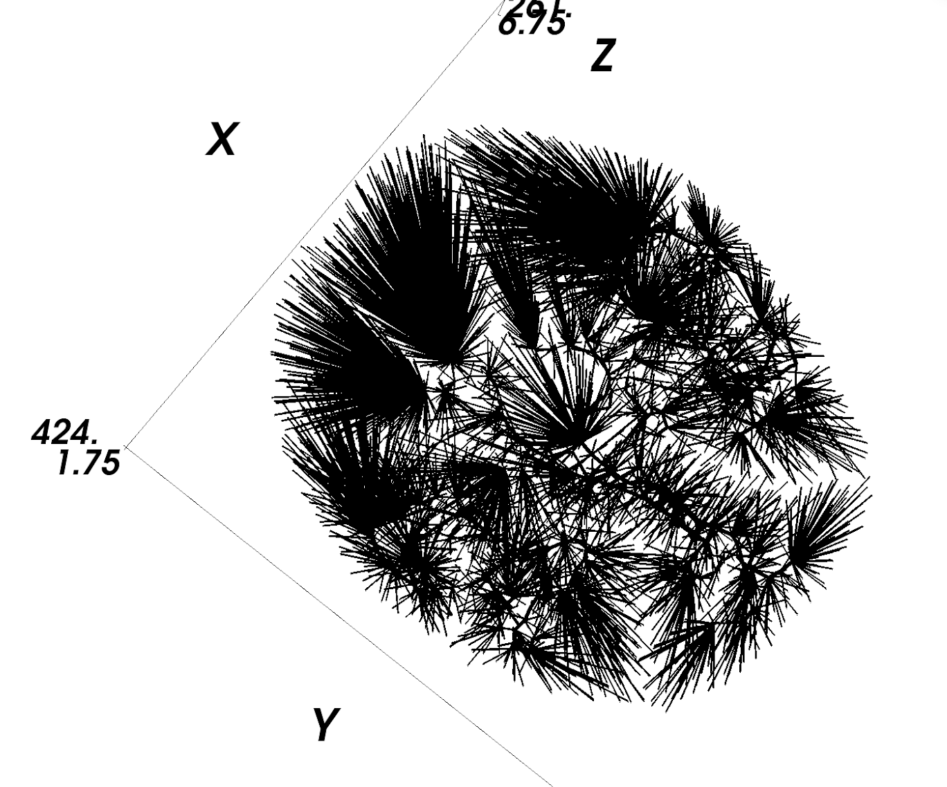
GCO Forest on Brain Vascular Network
Connect leaf nodes with nearest fixed nodes
Fixed node number: 1099
Leaf node number: 3016
GCO Forest Initialization

Slide 21
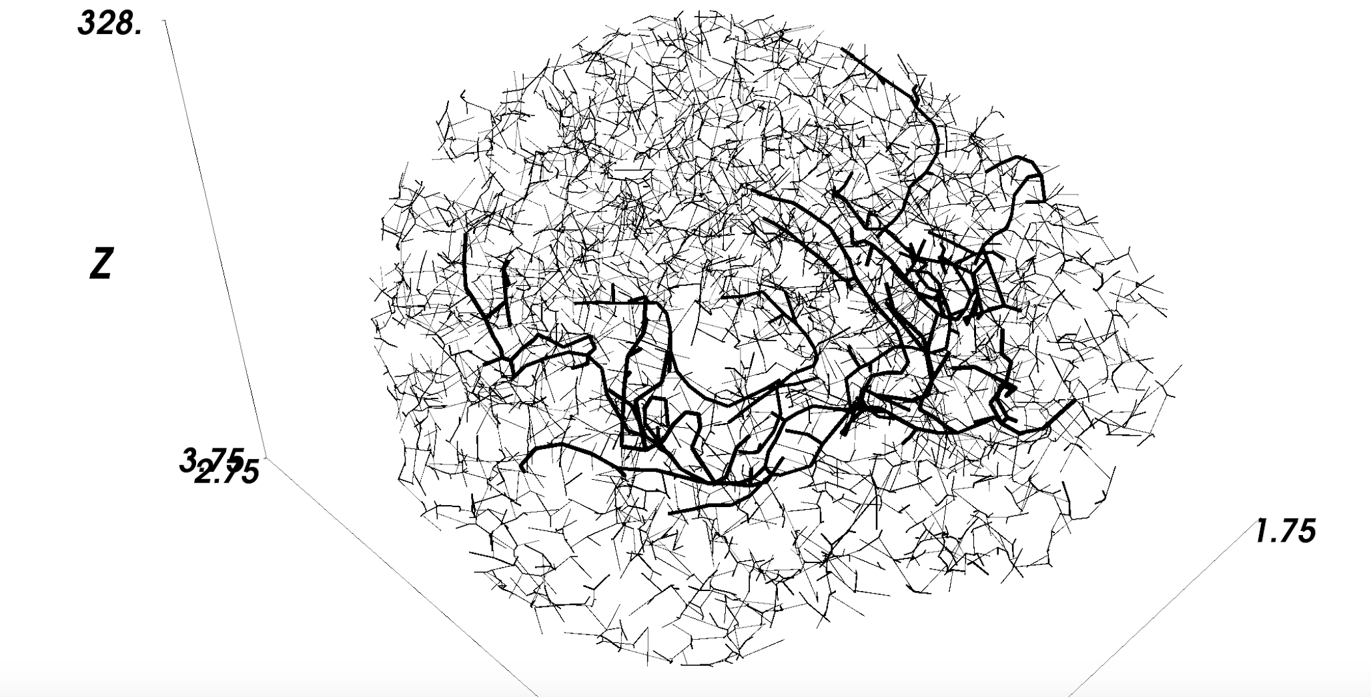
GCO Forest: Result
GCO Result

Slide 22
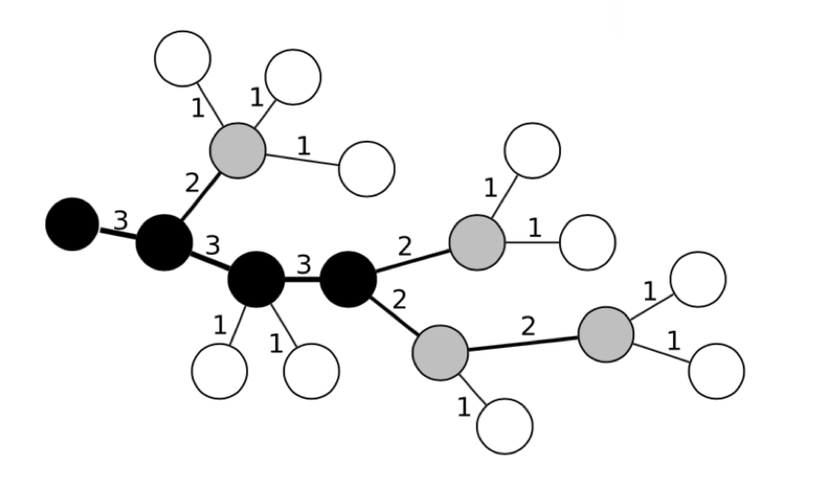
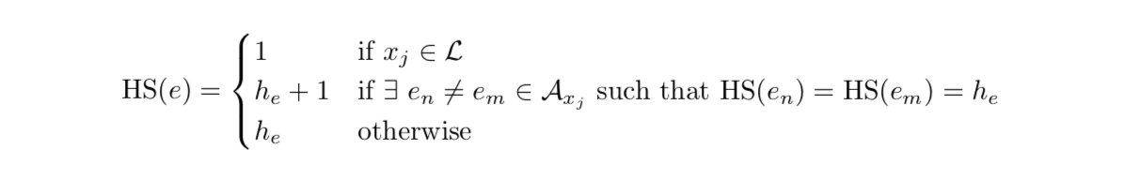
Characterize Trees: Horton-Strahler Order
Example of Strahler Order

Slide 23
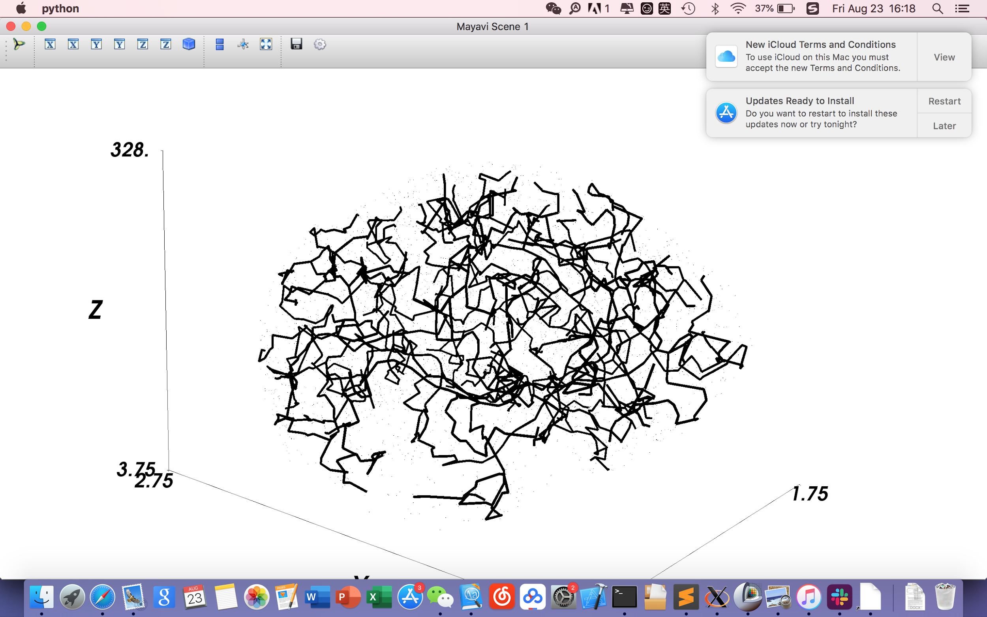
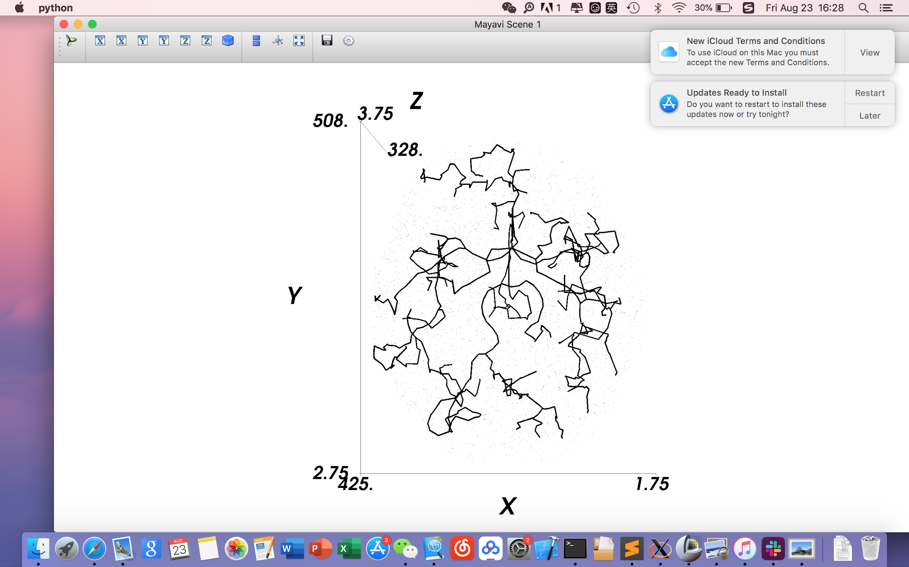
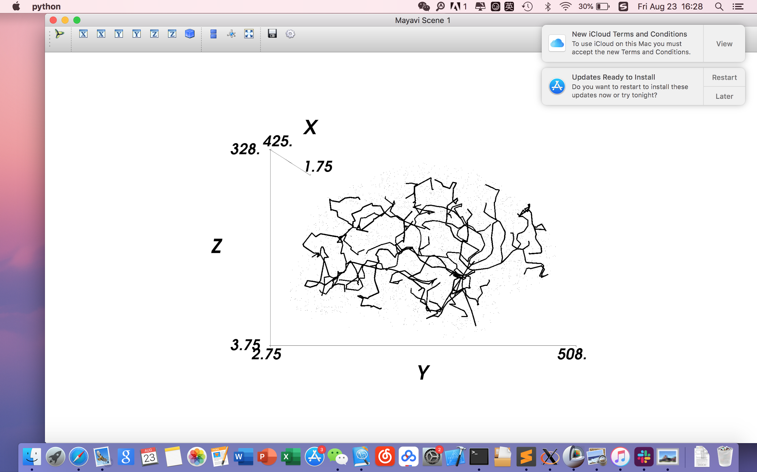
GCO Forest: Result
Vessels with Strahler order > 2
Vessels with Strahler order > 3
GCO Result

Slide 24
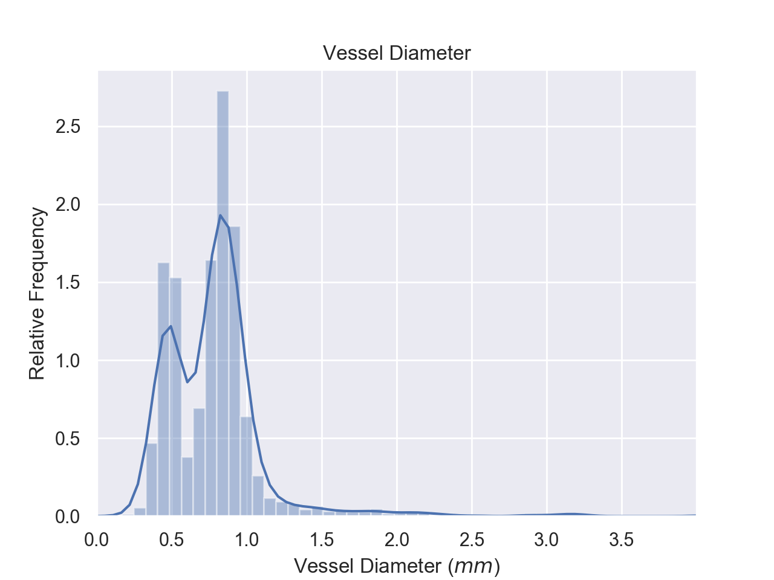
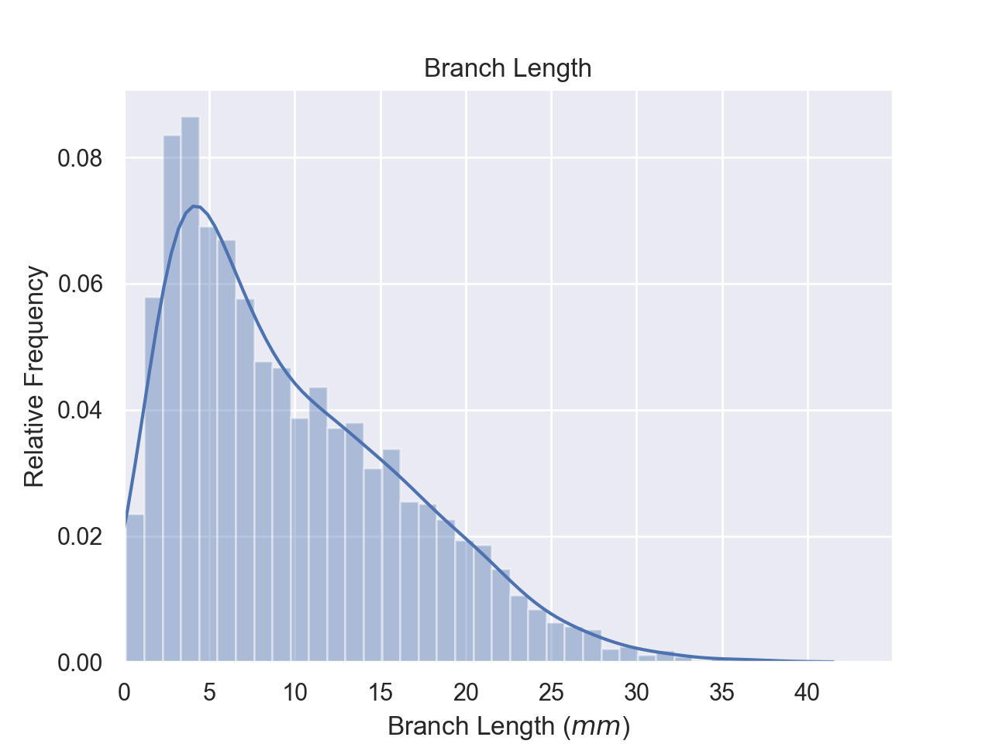
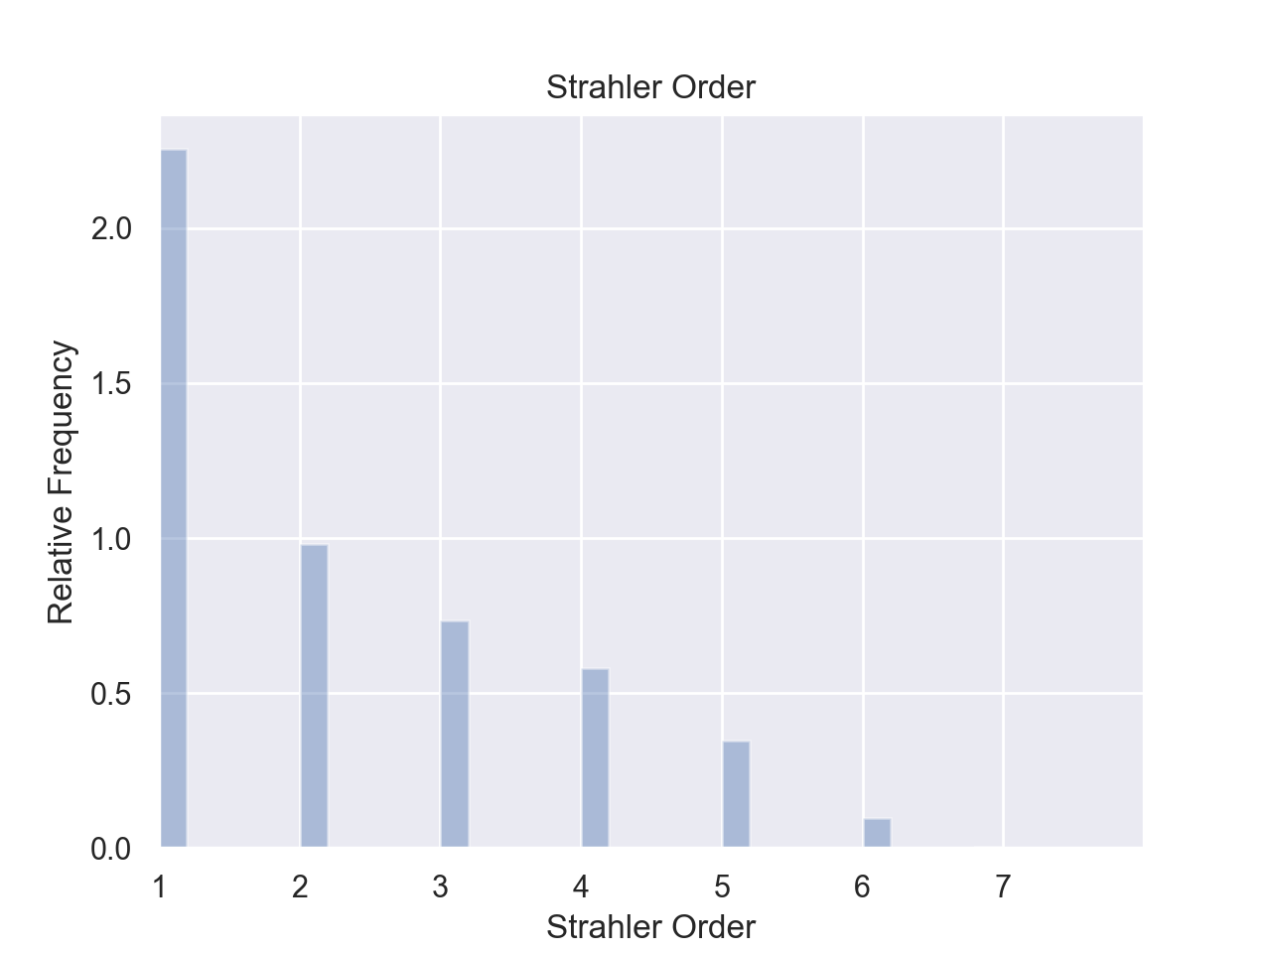
Result Analysis: Validation
Diameter / Branch Length / Strahler Order Frequency
Diameter Distribution
Branch Length Distribution
Strahler Order Distribution

Slide 25
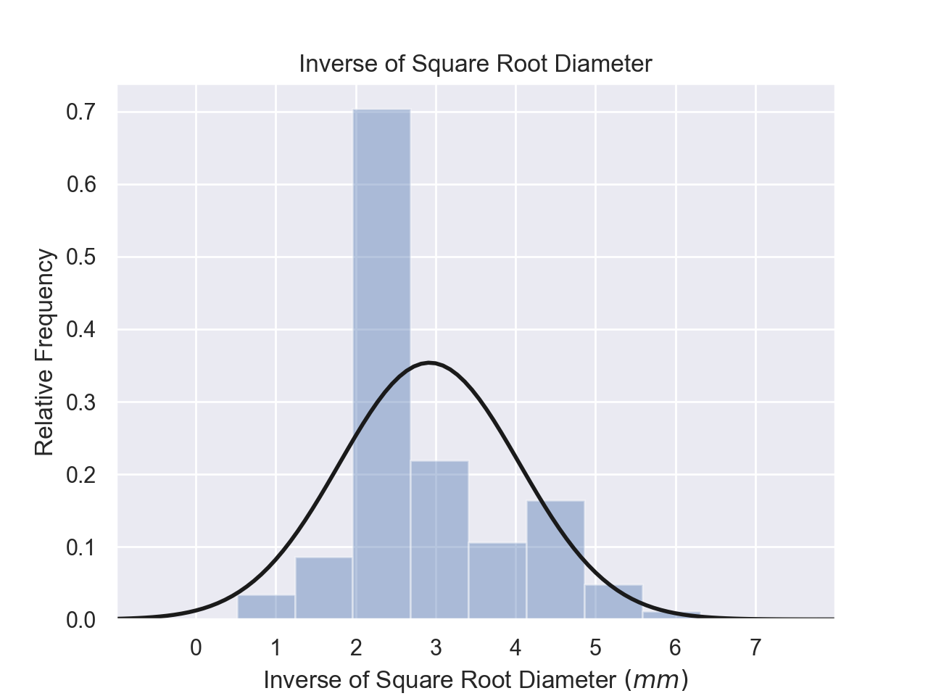
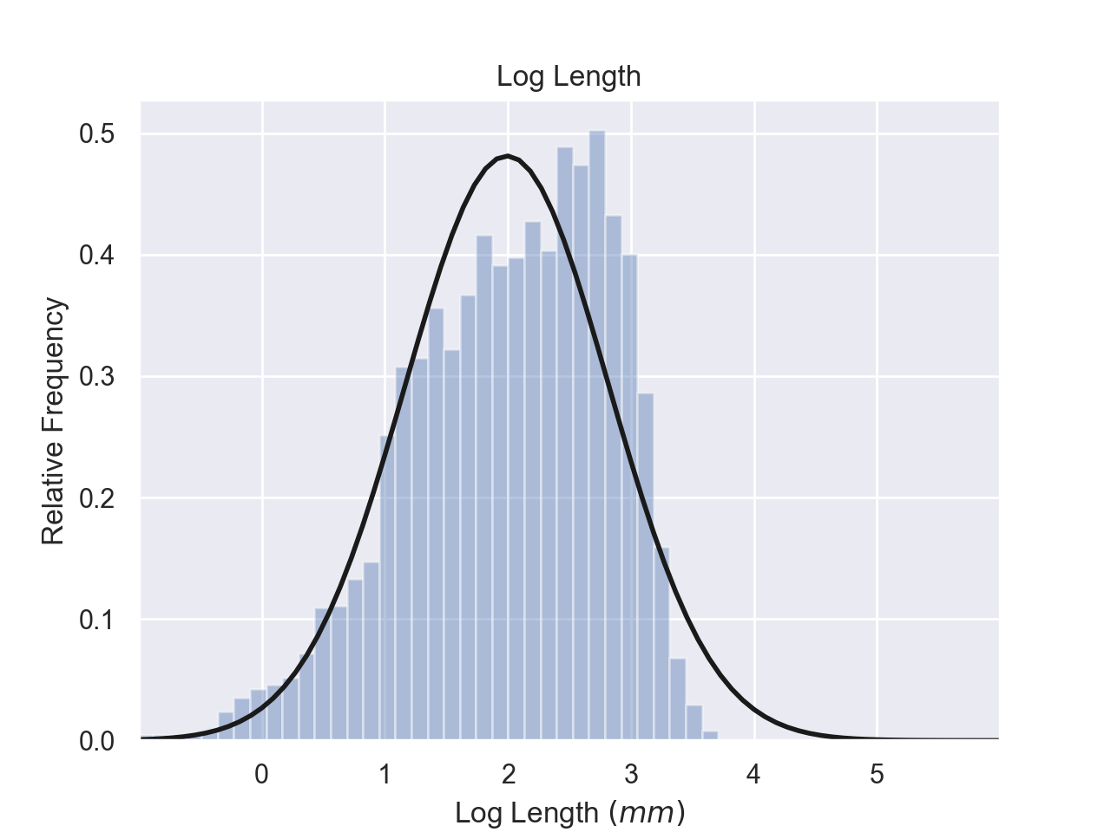

Result Analysis: Validation
Inverse Square Root of Diameter / Log Branch Length
Distribution of $1/{\sqrt{d}}$
Distribution of $\log{l}$

Slide 26
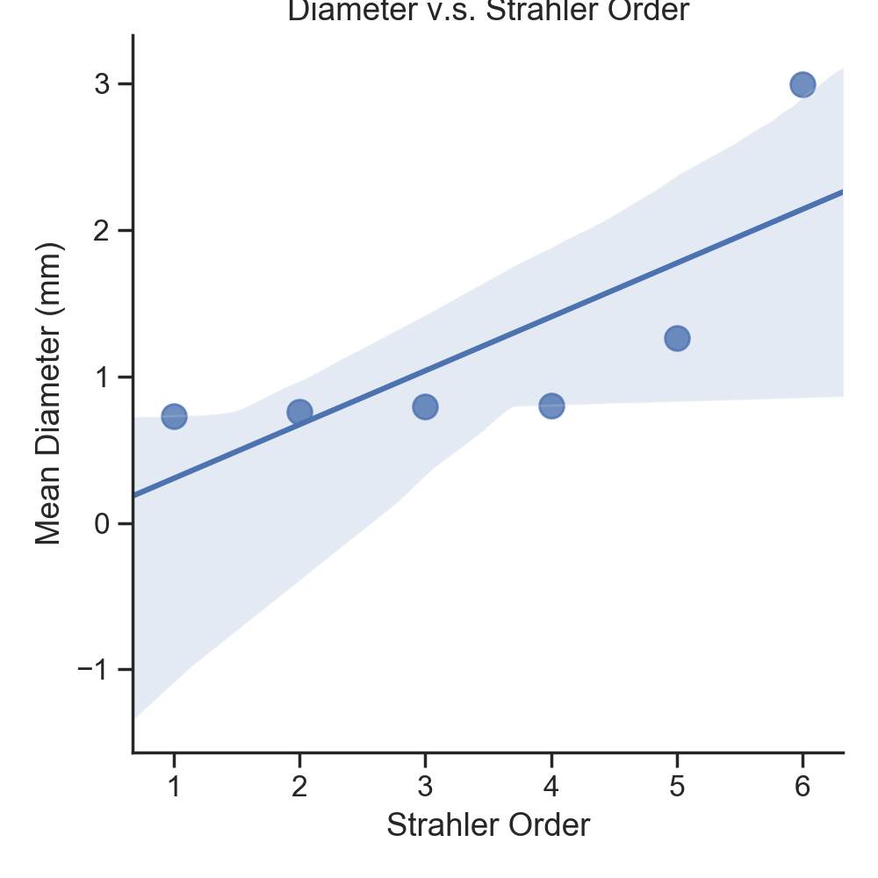
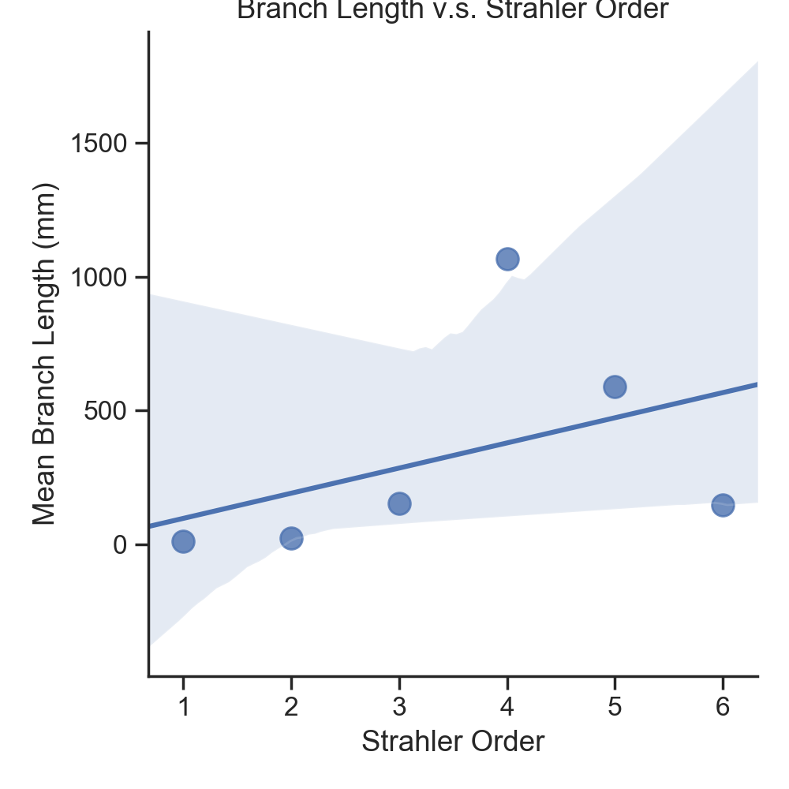
Result Analysis: Validation
Strahler Order v.s. Mean Diameter / Mean Branch Length
Mean Diameter for each HS order
Mean Branch Length for each HS order

Slide 27

Analysis: 3D Visualization of Final Model
Reconstructed 3D Brain Model

Slide 28

Analysis: Blood Flow Modelling
Mesh generation
Geometry needs some cleansing before performing actual calculations
Aim: model the flow to get pressure distribution and wall shear stress and compare it with actual data
Reconstructed Vessel Model

Slide 29
Future Work
Further modelling of blood flow and shear stress
Incorporate vesselness map into Simulated Annealing algorithm
Incorporate more physiological properties into the cost function

Slide 30
Acknowledgements
Special thanks to the Fields Institute for organizing the program
We feel deeply indebted to our supervisor Dr. Nima Maftoon and his PhD student Sina Anvari Naeini for guiding us through the course of this project

Slide 31
Thank You!

